Slide 1
I400 – Application Development in Java
Lab 1

Slide 2
Today
CH 3 – Selections / Conditionals
Booleans
If statements
Switch statements
If you miss anything today, please note that all slides from lecture are posted to Canvas.

Slide 3
Declaring Values
boolean values in Java can be true or false:
boolean selected = false;
boolean repeat = true;
Note: Java’s true and false begin with a lowercase letter, unlike in Python!

Slide 4
Boolean Values & Operators
Conveniently, the Boolean operators in Java are the same as in Python.
Operator | Name | Example | Truth Value
== | Exact Equality | 5 == 6 | false
!= | Not Equal | 5 != 6 | true
> | Greater Than | 5 > 6 | false
>= | Greater Than or Equal | 5 >= 6 | false
< | Less Than | 5 < 6 | true
<= | Less Than or Equal | 5 <= 6 | true

Slide 5
Other Boolean Operators
The same compound Boolean operators exist, but use unique symbols in Java:
Operator | Name | Example | Truth Value
! | Not | ! ( 10 > 20) | true
&& | And | (5 == (10 / 2)) && (1 > 2) | false
|| | Or | false || (8 % 2 == 0) | true
^ | Exclusive Or | (5 == (10 / 2)) ^ (1 > 2) | true

Slide 6
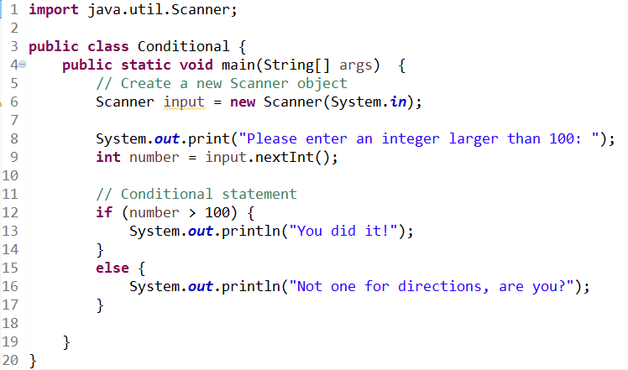


Branching
Just like in Python, conditional statements in Java use Boolean Conditions. Here’s an example if statement:

Slide 7

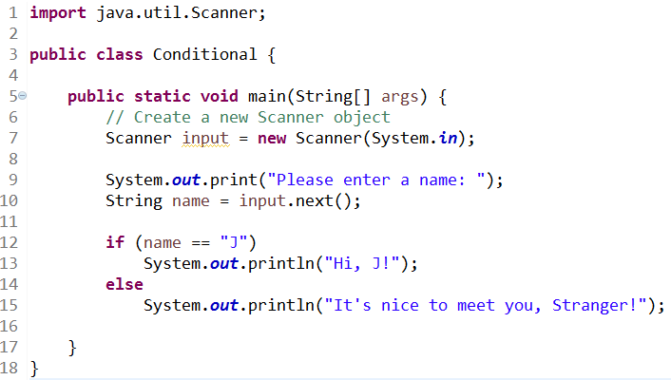

Be Careful!!
Surprise! Strings are objects, and == tests for two objects being the same object.
We’ll see how to handle this shortly…

Slide 8
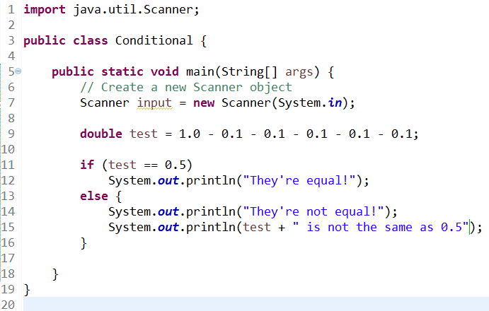

Be Careful!!
Surprise! Doubles (and all floating-point numbers) in Java are approximate! They may have rounding errors.
Integers are exact, however, so they’re safe!

Slide 9
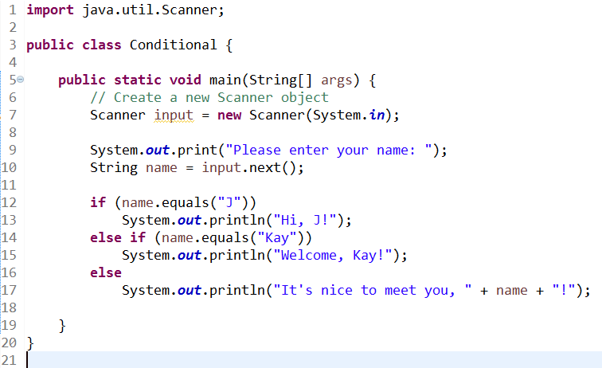
Branching
We can use .next() to get a String from the console. NOTE: This only works if the String has no spaces in it!

Slide 10
Branching
We can also add additional branches with else if .

Slide 11
Branching
To test if two strings are equal, we’re using the .equals() method.

Slide 12
Branching
Finally, we notice that if your code block for a conditional is only 1 line, you can omit the { }
Be very careful! It’s easy to forget the brackets if you add more code later!!

Slide 13
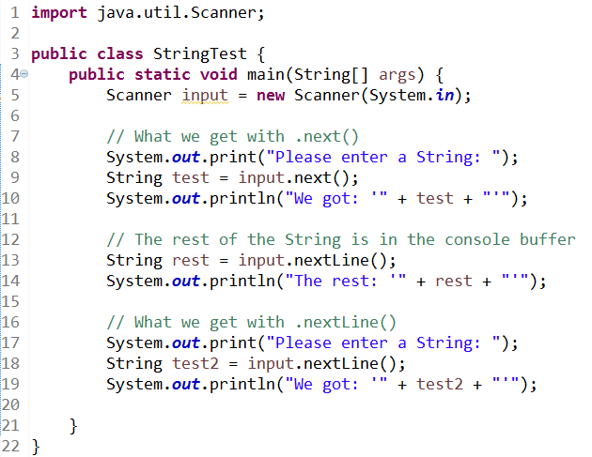
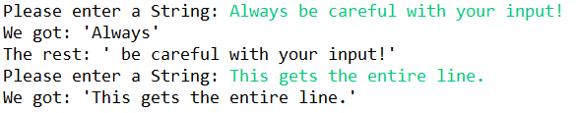
Caution: .next() vs .nextLine()
.next() only grabs the console input up to the first space. If you want the whole line, use .nextLine()

Slide 14
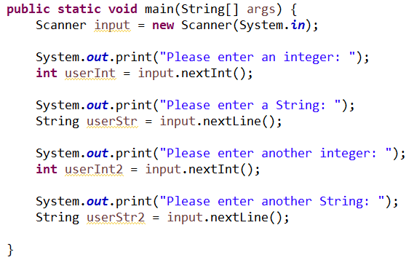

Console Input
What’s going on here??

Slide 15
Console Input
.nextInt() and .nextDouble() don’t always consume the newline at the end of the current line of input from the console.
If you find that one of your prompts is “running over” the other, you can add a call to .nextLine() to fix this.

Slide 16
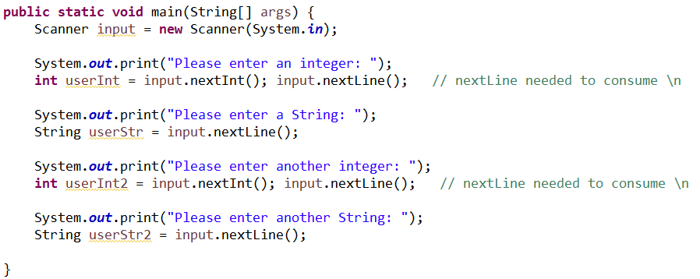

Console Input
Now it works!

Slide 17


Distance (Group Work)
Write the DistanceConversion class, which converts distances in Miles or Kilometers to the other unit. For reference, 1 Mile = 1.60934 Kilometers, and 1 Kilometer = 0.621371 Miles.

Slide 18
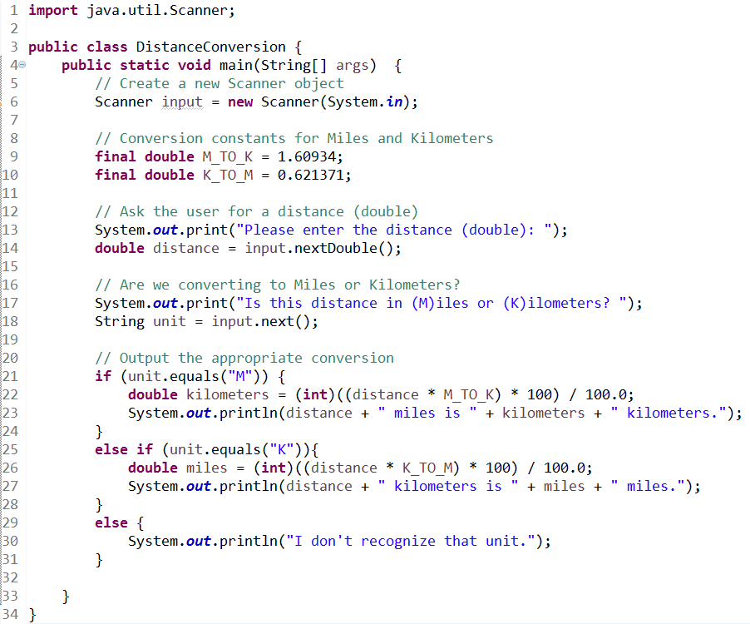
Distance (Solution)

Slide 19
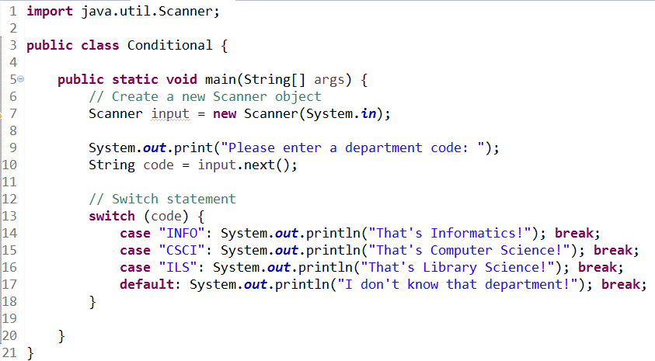
Switch
Java also offers the ability to use switch statements, which are good for conditional statements where single values are being matched:

Slide 20
Switch
The rules for a switch statement are:
The variable/expression being switched on must be a char, byte, short, int, or String.
The cases must have constant values, not variables.
The default case is optional.
Encountering a break ends the switch immediately. If no break is found, the code proceeds to the next case (called falling through).

Slide 21
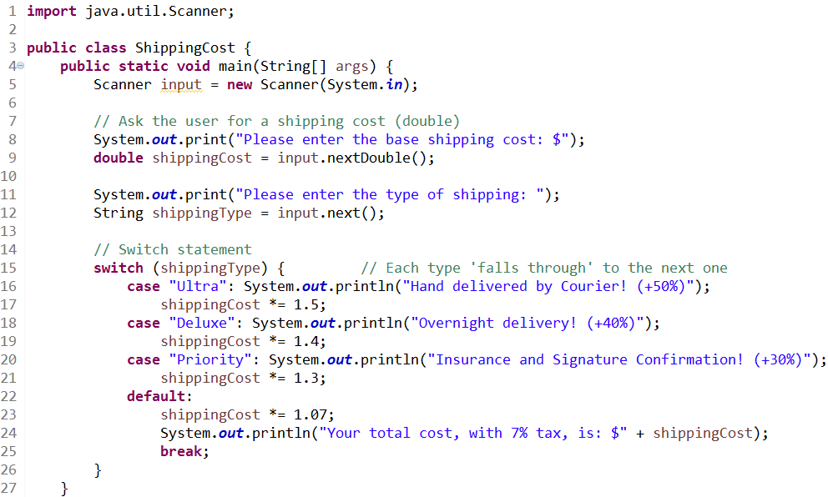
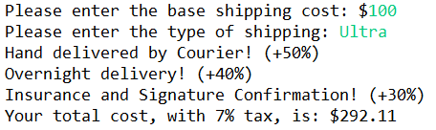


Switch – Falling Through
If you have cases that include other cases, falling through is ideal!
In this problem, each Tier of shipping includes the features of all of the subsequent Tiers, so we fall through all the way to the end!

Slide 22



User Lookup (Group Work)
Write the UserLookup class, which identifies whether a given name belongs to one of classes of users in the system. Write 2 versions of this class – one that uses an if statement, and one using a switch statement.
Category | Names
Programmer | Adam, Beatrice, Chang, Devi
Admin | Edgar, Fatima, Greg, Henrietta

Slide 23
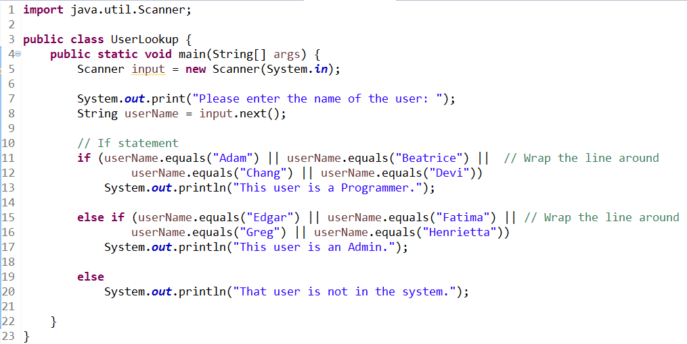
User Lookup (Solution - If)

Slide 24
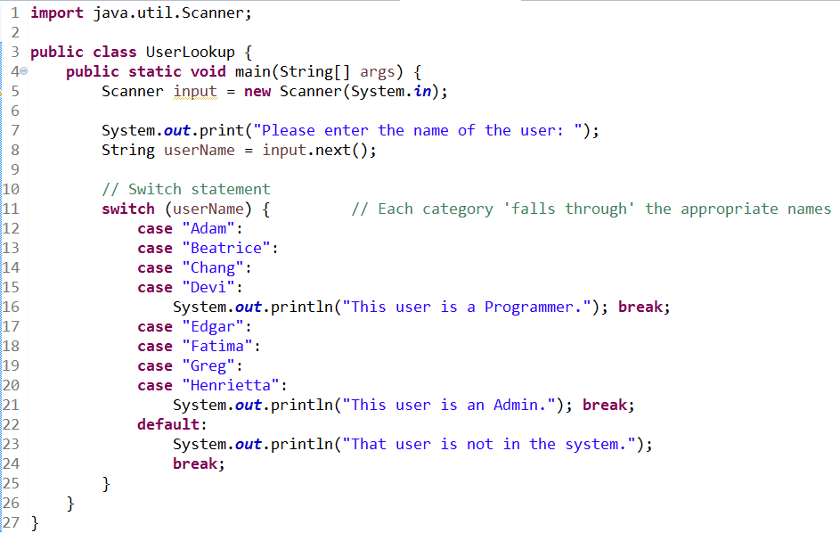
User Lookup (Solution - Switch)

Slide 25
Questions?

